Slide 1
Data Management Practices:
BCO-DMO’s Successes and Challenges
Bob Groman
BCO-DMO
Woods Hole Oceanographic Institution
NERACOOS/NeCODP
Data Management Workshop
September 26, 2012

Slide 2
BCO-DMO is funded by NSF
In 2006, two data management offices were united and enhanced, and supported by an NSF grant: US JGOFS and US GLOBEC ➔ Biological and Chemical Oceanography Data Management Office (BCO-DMO).
BCO-DMO is recognized in the 2011 Division of Ocean Sciences Sample and Data Policy (NSF, 2011) as one of several program-specific data offices to support NSF OCE funded researchers.
Notes:
Early meeting with Biological and Chemical Oceanography NSF program managers
NSF request proposal to merge both US JGOFS and US GLOBEC DMOs
Much synergy between these two DMOs – used same software to share data JGOFS/GLOBEC, developed by Glen Flierl, Dave Glover, and others. More importantly, we shared the same philosophy.

Slide 3

What is BCO-DMO?
BCO-DMO staff provide data management support
for investigators and projects funded by NSF Ocean
Sciences Biological and Chemical Oceanography Sections
and NSF OPP ANT Organisms & Ecosystems Program
We:
  Partner with individual investigators and those associated with collaborative research projects
  Support data management throughout the project
  Capture and record documentation (metadata) sufficient to support data reuse and re-purposing
  Manage data and metadata and ensure their availability online
  Archive in appropriate data center (e.g. NODC); and cooperate and contribute to special repositories (e.g. CDIAC, OBIS, GenBank)
  ‘proposal to preservation’
Notes:
3
The Biological and Chemical Oceanography Data Management Office (BCO-DMO) was created to serve PIs funded by the NSF Geosciences Directorate (GEO) Division of Ocean Sciences (OCE) Biological and Chemical Oceanography Sections and Office of Polar Programs (OPP) Antarctic Sciences (ANT) Organisms & Ecosystems Program. BCO-DMO manages and serves oceanographic biogeochemical, ecological, and companion physical data and information developed in the course of scientific research and contributed by the originating investigators.

Slide 4
About the data and the contributors:
Since before 2006 we have been partnering with investigators to help support their data management needs
We accommodate a wide variety of biological, chemical, and physical oceanography measurements and modeling results. Data are added or updated daily.
In addition to providing access to the metadata, we also provide online access to the data in a consistent manner, with sufficient metadata so others can make full use of these data.

Slide 5
Our system:
Metadata stored in a MySQL relational database
Backend data access is via the JGOFS/GLOBEC data management system supporting tabular data, images, movies, links, etc.
Text based access via Cold Fusion (with conversion to Drupal access this Fall)
Geospatial access via (OGC compliant) MapServer
Tool to convert metadata to FGDC standard (cross walk)
Download/extract data in many formats including CSV, TSV, Matlab, ODV, netCDF, KML, WMS, and WFS

Slide 6
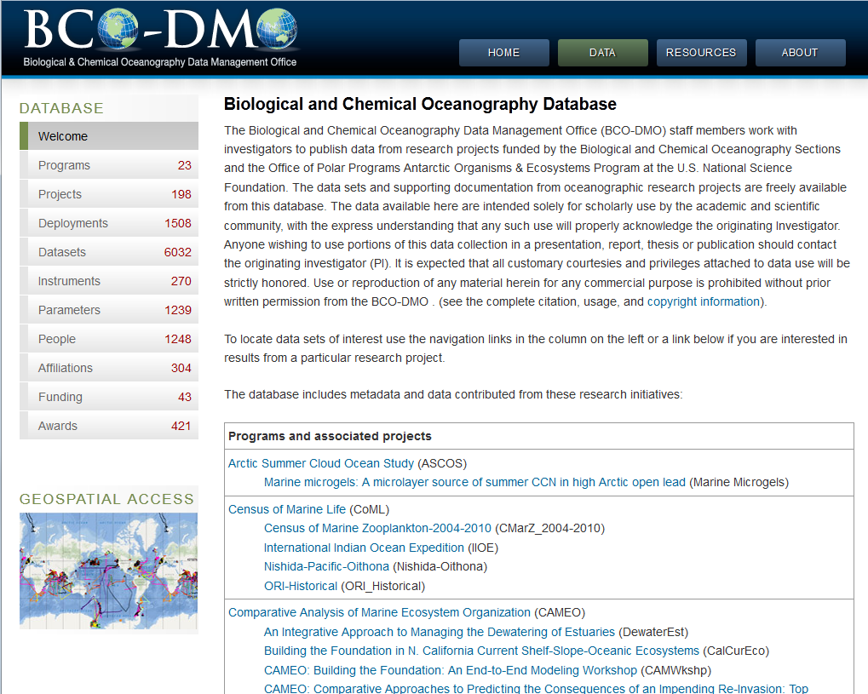
Text-based access – www.bco-dmo.org
How do we accomplish our task?
Notes:
Do example by person, e.g. Peter Wiebe

Slide 7
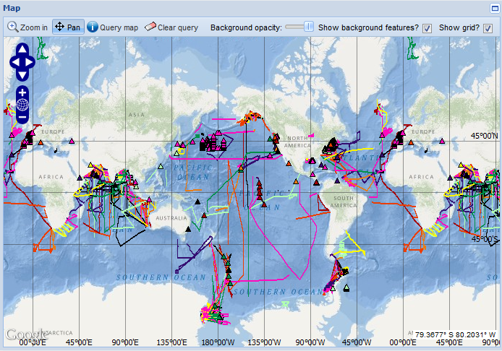
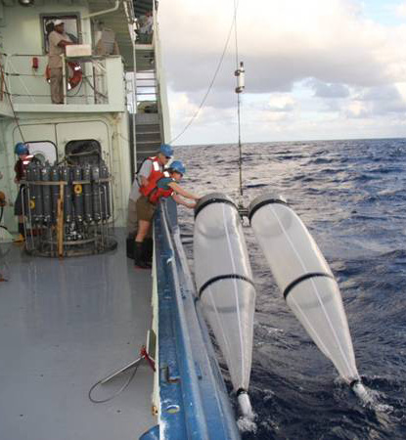
MapServer - www.bco-dmo.org
How do we accomplish our task?
in situ data from research cruises are documented and added to the
online data system and discoverable through two user interfaces.
Original data from Bongo net tows
and CTD/Niskin Rosette
Notes:
University of Minnesota MapServer software, modified for our purposes.
Image shows all currently available deployments (cruise tracks, buoys,
etc.)

Slide 8
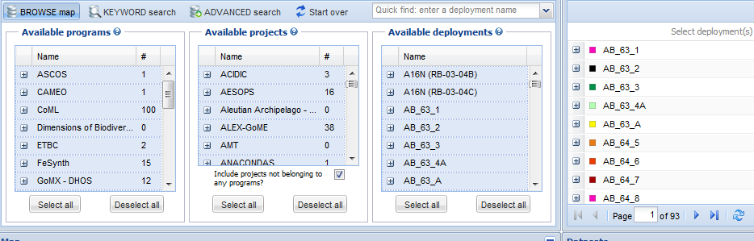
Three facets and available deployments
Let’s go there

Slide 9
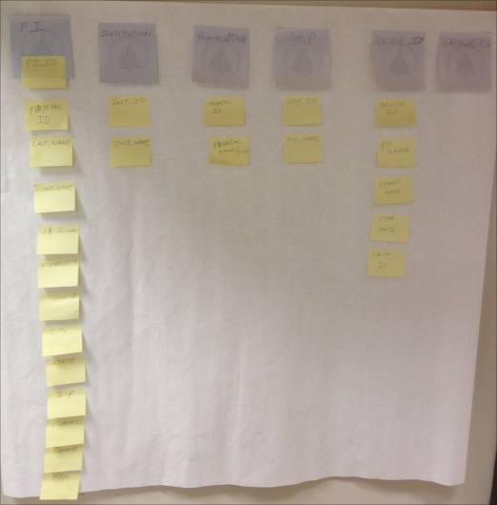
Data Management Successes
“Standards are guidelines.” [Jane Greenberg, UNC]
Build a system to suit your users’ needs
Be flexible
Phased implementation of goals (ontologies, etc.)
Do things that are needed, not just because they can be done.

Slide 10
How the system is used:
Keyword search in MapServer
Rubber banding boundary in MapServer
Category search in text-based interface
Faceted search in (beta) advanced search
View the data for fitness of purpose
Notes:
Success can be measured by how many data points are available, or how many datasets are accessible. But the quality of the metadata and data are even more important than the numbers.

Slide 11
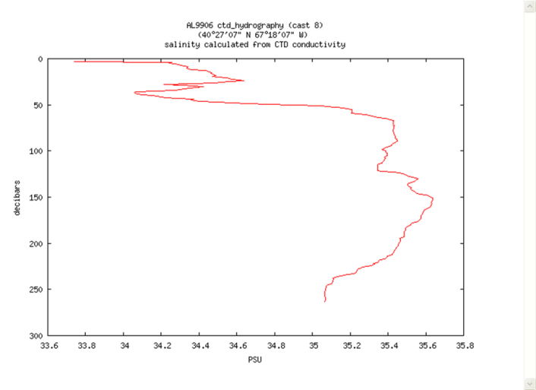
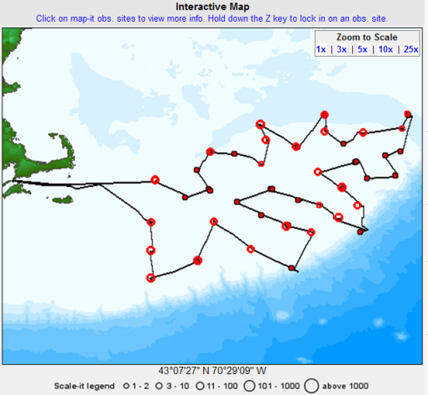
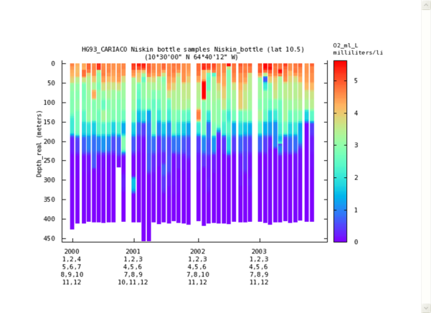
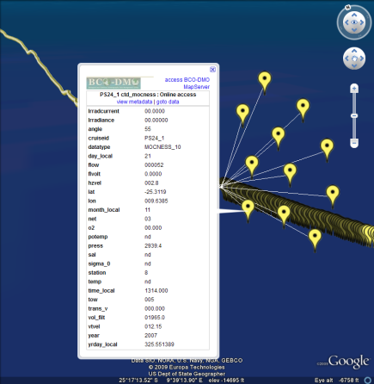
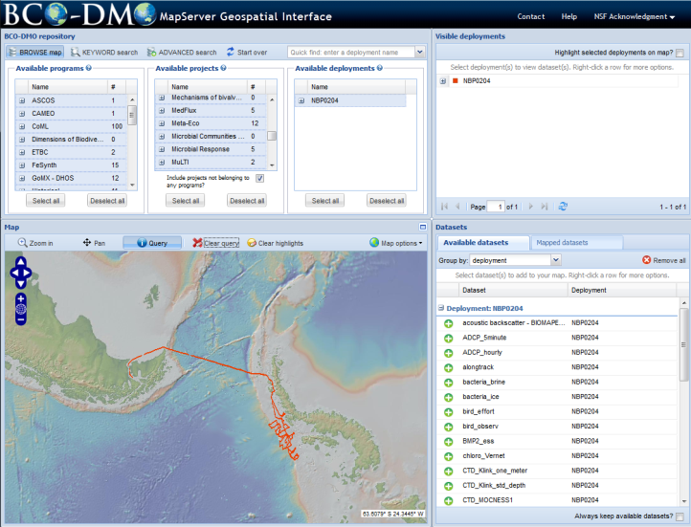
Successes (continued): How the system is used

Slide 12
Challenges
BCO-DMO approach is labor intensive
  This is fundamental to our success
  Go to science meetings
  Read the science papers
Does it scale?
Lack of standards/too many standards
Interoperability (deserves its own slide)
Notes:
“BCO-DMO is not your enemy. They are your only hope.”

Slide 13
Challenges: Achieving Interoperability
What else is needed?
The ability of different data repository systems to exchange and integrate data and information and present a unified view to the user.
  Requires syntactic (format) compatibility.
    e.g. access/security, file formats, transfer protocols.
    to retrieve data and information.
  Requires semantic (language) compatibility.
    e.g. metadata standards, controlled vocabularies, ontologies
    to understand data and information.

Slide 14
Challenges: New expectations for data access
New tools based on emerging technologies are being developed to address the challenge of
integration of distributed heterogeneous data
Informatics
Semantic mediation
Controlled vocabularies
Registered ontologies
Federated search
Faceted browse – semantically enabled search
OBIS
GenBank
!
NODC
BODC
BCO-DMO
Notes:
Federated search: simultaneous search of multiple searchable resources
Faceted browse: accessing information organized according to a faceted classification system; Facets correspond to properties of the information elements.
Once you find the data, determine fitness for purpose, download them … now what?
Do you have sufficient metadata to accurately interpret the data?
‘distributed heterogeneous data’, e.g. marine science data stored in different data repositories, e.g. OBIS, GenBank, BCO-DMO, BODC, NODC

Slide 15
BCO-DMO: Data Discovery and Availability
How do we accomplish our task?
Our primary task is to ensure that data from NSF OCE funded awards are freely available and usable online
The BCO-DMO data system and interfaces facilitate
  data discovery
  data access to assess fitness-for-purpose
  data export and download
  data preservation in a permanent archive such as the National Oceanographic Data Center (NODC)
Bob Groman, rgroman@whoi.edu 508-289-2409

Slide 16

http://www.bco-dmo.org
“A metadata standard is like a toothbrush; everybody agrees we should use them but nobody wants to use anybody else's.”
Bob Groman, rgroman@whoi.edu 508-289-2409

Slide 17
Acknowledgments
Cyndy Chandler, Peter Wiebe and M. Dicky Allison for the reuse of several of their slides

